Slide 1
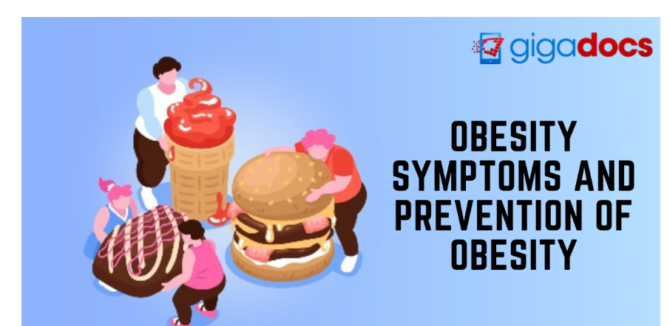
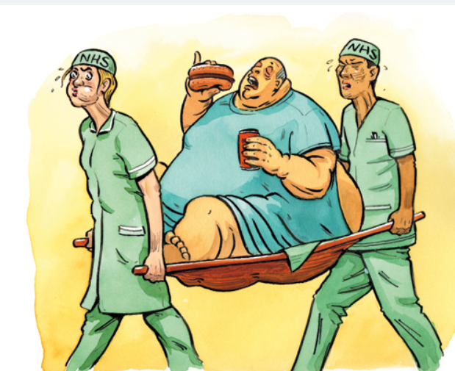
Predictive Analysis in understanding the Influential factors on Obesity

Slide 2
Introduction
Obesity is a chronic complex disease defined by excessive fat deposits that can impair health.
Obesity can lead to increased risk of type 2 diabetes and heart disease, it can affect bone health and reproduction, and it increases the risk of certain cancers.

Slide 3
Hypothesis
Null hypothesis - is there any correlation between obesity and factors such as family history, smoking, food habits, physical activity
Alternate hypothesis - there is no correlation between any of such factors and obesity

Slide 4
Business value
Target Market: This can be used in the healthcare and fitness industry by manufacturing and recommending products to the client.
Personalized products for an individual: These insights can be used by a fitness app which can analyze the data in real time and can suggest personalized advice to each individual.
Health insurance companies: Health care insurance can use these insights for potential risk of a person to be infected by any diseases have to pay a higher premium.
Prediction of health issues: Hospitals can use these insights and analyze the data for potential diseases which a general population can get affected by it in future. So, with this they can take a potential step for betterment of them.
Reward system: Few app are designed that people get in return if they follow healthy habits if they know that they have high chances of being obese so they would go under reward model to discipline themselves to follow healthy habits.

Slide 5
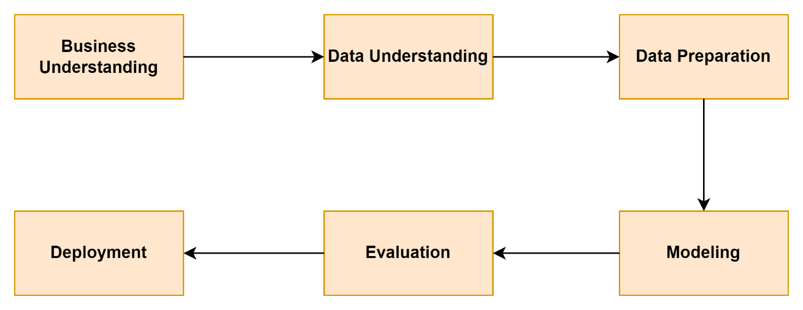
CRISP-DM Methodology

Slide 6
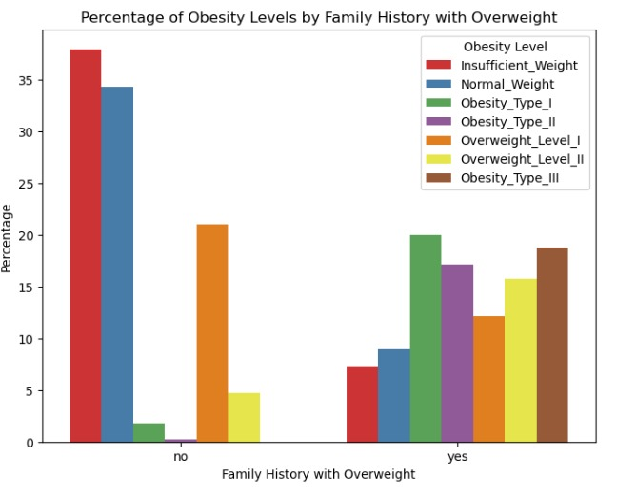
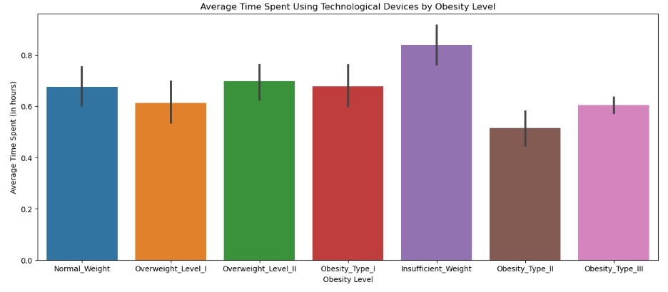
Data Visualization

Slide 7
Models and Accuracy
Application of techniques like K Nearest Neighbour, SVM, Logistic Regression ,Decision Tree ,Random Forest
Logistic Regression | 72.8%
Random Forest Classifier | 93.6%
K Neighbour Classifier | 82.2%
Decision Tree Classifier | 79.6%
SVM Classifier | 83.2%

Slide 8
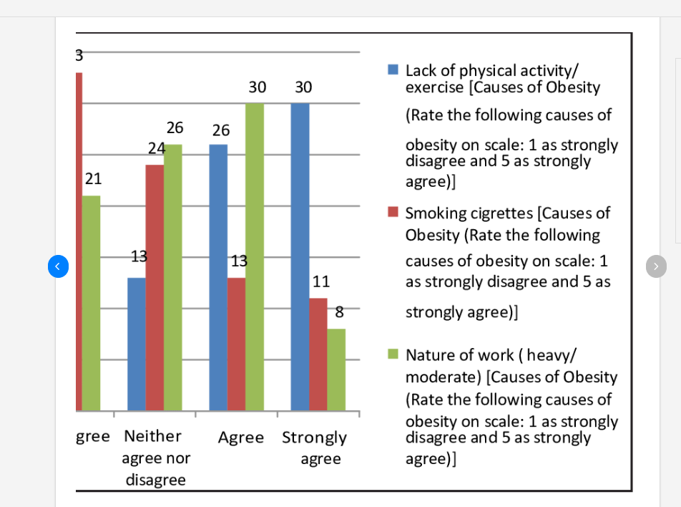
Top 3 factors influencing obesity

Slide 9
Thank You

